Slide 1
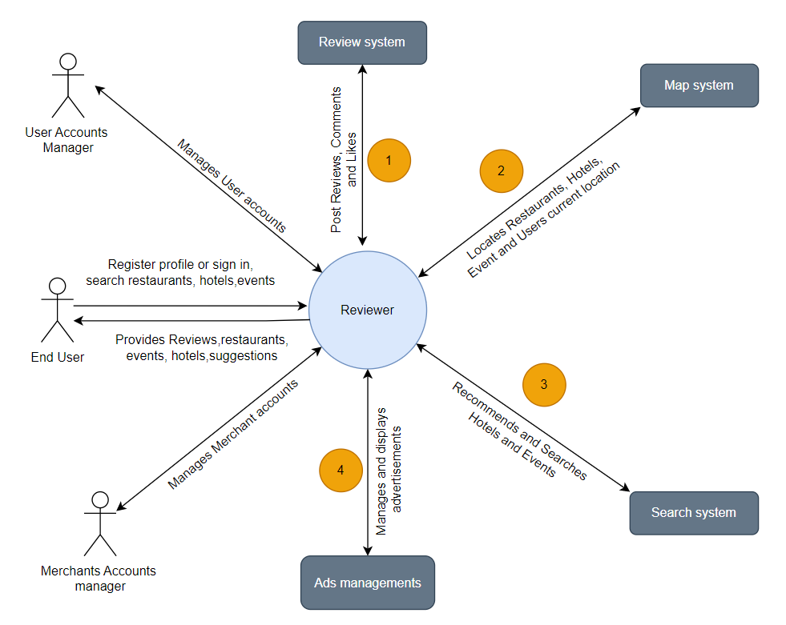
Reviewer - Context Diagram

Slide 2
System Interface Table
No | Description | Source | Target | Frequency | Validation
1 | Review hotels and events | Review system | Reviewer | Real time | Validated with associating the review_id and respective user_id
2 | Locates Restaurants, Hotels, Events and User’s current location | Map System | Reviewer | Real Time | User allows location while visiting website
3 | Search for hotels and events | Search system | Reviewer | Real Time | Search keywords are matched with hotels/events description and name.
4 | Manages and Displays Advertisements | Ads Management | Reviewer | Real Time | Ads are validated by third-party vendor using user’s search history.

